Slide 1
C++
An Adventure Game
Joanna Veilleux

Slide 2
Getting Started

Slide 3
Getting Started
INSTALLATION
It is not installed
It is a compiled language
WHERE TO WRITE PROGRAMS
Text-editor
.cpp extension
IDE(Integrated Development Environment)
Notes:
INSTALLATION
C++ is not installed on the operating system.
This is due to the fact that it is a compiled language, which essentially means that:
You can compile programs
Run programs
Debug programs
All from your command line (but you must have a C++ compiler on your machine)
If you use an IDE it will “encompass” the compiler and provide all the same
capabilities.
WRITING PROGRAMS
You can write C++ programs in a text-editor, but you must save it with
a .cpp extension in order for the compiler to recognize it as a C++ program.
You can also use an IDE as stated before.

Slide 4
Programming Environment

Slide 5
Programming Environment
RECOMMENDED PROGRAMMING ENVIRONMENTS
Eclipse
Code::Blocks
NetBeans
Qt Creator
Dev C++
C++ Builder
Visual Studio
CLion
Vim
CodeLite
Notes:
I decided to use Visual Studio 2017
Was recommended by a fellow programmer I know
Microsoft product
Familiar with the brand
I found it pretty easy to use, though it took awhile for me to get the hang of it.

Slide 6
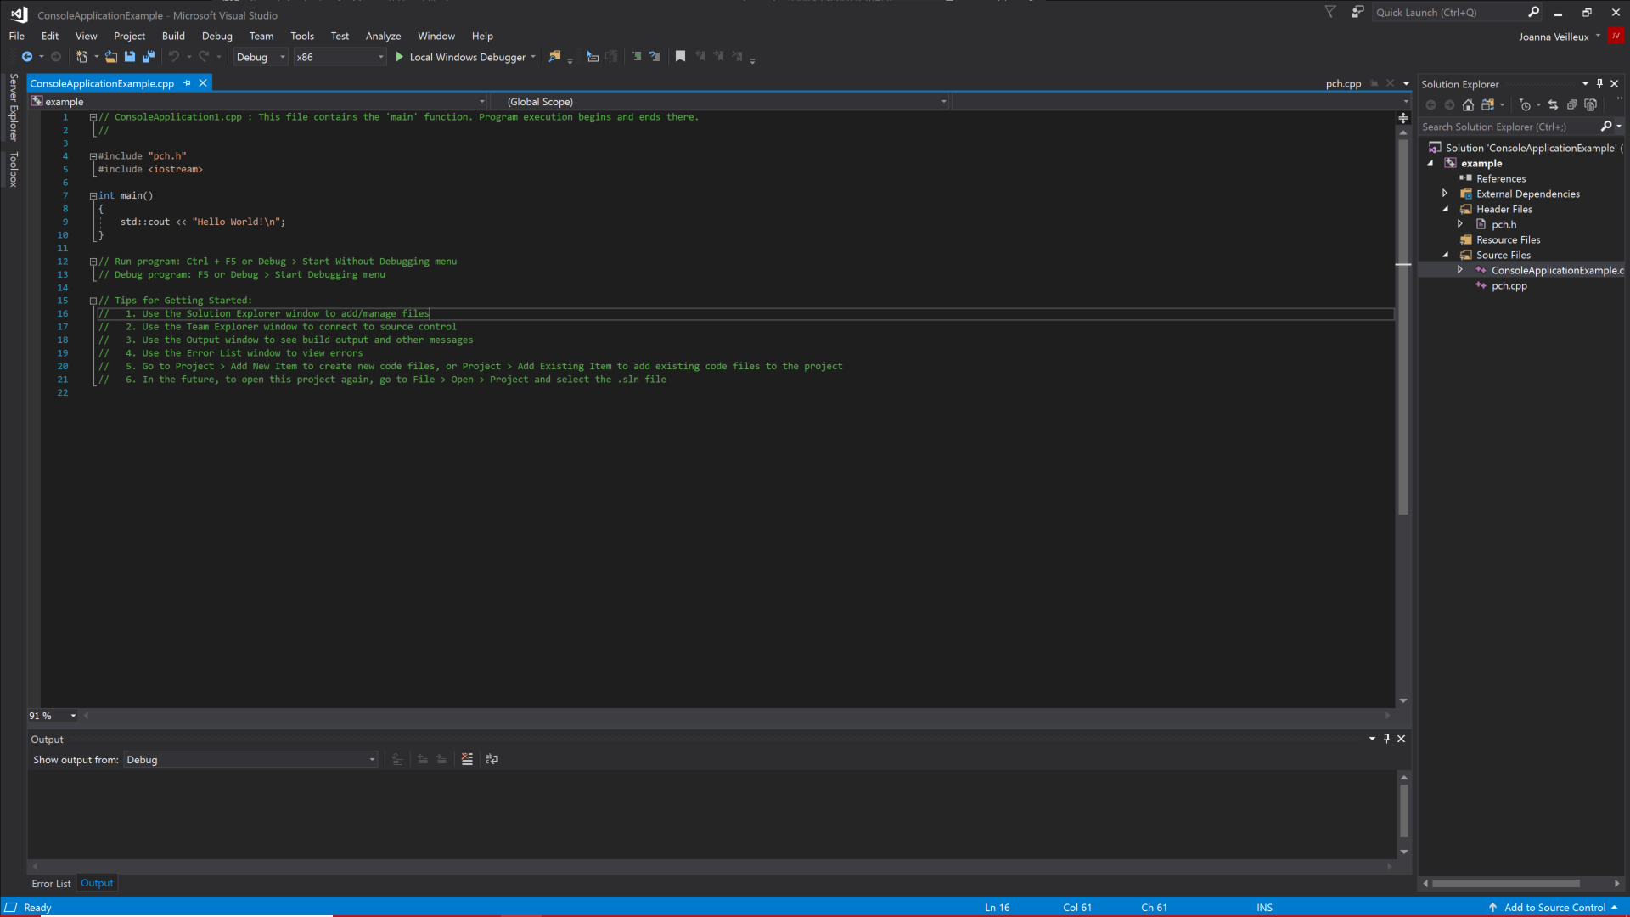
4..
1..
3..
2..
Notes:
Main window, this is where you write the programs
This is what shows up when you create a new project
This is the solution explorer, where you can navigate through your various files
This is the debug window, if errors are found when debugging they will show up here
This is the Local Window Debugger, click on it to run and debug your program
When you hit this, the program will open in a terminal window
You can also hit F5

Slide 7
Writing Code in C++

Slide 8
Writing Code in C++
Not a lot of boiler-plate code
Int main( ){ }
Precompiled headers
#include “pch.h”
Can be disabled
Comments
//
/* */
Notes:
There is not a lot of boiler-plate code in C++, so for the most part you can start writing code
However, you should always include an int main() function, as this is what is executed when you run your program.
There are also precompiled headers, that can reduce the time it takes to compile your code
To use these you must write #inlcude “pch.h” at the top of your program
These are on by default but they can be turned off
This is only per project though, so you will need to redo this every time you make a new one.
COMMENTS
Single-line comments are two backslashes
Multiline comments are a backslash accompanied by an asterisk to denote the beginning of the comment block and an asterisk accompanied by a backslash to denote the end of the comment block
Important to note that comments should be used to describe what the code is trying to accomplish and how it is going to accomplish it

Slide 9
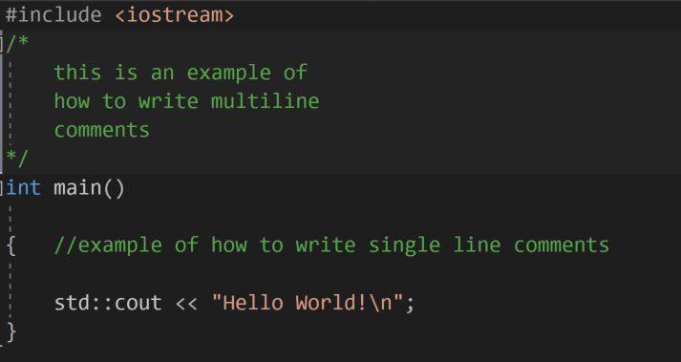

Slide 10
My Adventure Game

Slide 11
Quick Overview
adventure_game.cpp
Instantiate.cpp
Instantiate.h
Character.cpp
Character.h
Item.cpp
Item.h
Creature.cpp
Creature,h
Battle.cpp
Battle.h
Wisdom.cpp
Wisdom.h
Notes:
adventure_game is where the program is run
Game instructions
Start up information
Instantiates all the dummy databases for each class
Creates a character for the player
Game play
Instantiate.h
Goes through csv file line by line
Splits on the commas
Assigns the values to appropriate variables
Use variables to instantiate appropriate object
Add object to a map where the key is an index number and value is the object
Character.h
Setter and getter methods
Increase character health
Decrease character health
Add item to their inventory
Remove item from their inventory
Show inventory (displays the contents of the inventory)
Item.h
Setter and getters
Method to compare items
Creature.h
Setters and getters
Decrease health of creature
Battle.cpp
Meet creature
Fight creature
Wisdom.h
Get riddle
Get answer
Add riddle
Add answer

Slide 12
Item.h
adventure_game
Instantiate.h
Character.h
Battle.h
Creature.h
Wisdom.h

Slide 13
Item.h
Instantiate.h
Wisdom.h
Creature.h

Slide 14
Character.h
Battle.h
Creature.h

Slide 15
Character.h
Item.h

Slide 16
Look at Code / DEMO

Slide 17
Thank You!

